Slide 1

Optimizing Python
Faster, Smaller, and Lower Power
Notes:
Take
Printed papers for butterflies
Backup notes
USB Mouse
Need to have opened
Browser at 150% to embedded.fm, github with this project, https://rivolaks.com/posts/profiling-python/, https://jvns.ca/blog/2018/04/16/new-perf-zine/ godbolt.org
VSCode with cleaned project and terminal up, font size of editor and terminal set to 20
WSL: export PS1="$ "
PowerPoint
Cmd to correct directory: \Users\elecia\personalProjects\Presentations\OptimizingPython\src
Start
Good evening PyLadies and GentleBeings.
I am Elecia White.
My goal tonight is to give you some tools to optimize python.

Slide 2
Why? Why are you optimizing? Why optimize Python?
Usual answer to slow scripts: “Just use C. Or C++.”
Smaller systems
Raspberry Pi and other single board computers
TX2 and Nano and other SBCs that do machine learning
CircuitPython and microcontrollers
Smarter systems
AI: ML, DL, SVMs, all the acronyms
Video processing
Notes:
First let’s talk about the elephant in the room: why are you optimizing? Python is easy to use but not the fastest language. While you think about why you’d optimize python I have an egregiously long quote to read you.
Guido Van Rossum, author of the python programming language, was asked about Python being slow. His response was excellent
What people … do is they pick a tool and they build something incredible, and as part of the incredible thing they're building, they're doing crazy stuff, and sometimes some of the crazy stuff involves doing a whole bunch of computation, crawling through a graph of a billion social contacts or analyzing a trillion email messages or whatever.
At some point, you end up with one little piece of your system… where you end up spending all your time. If you write that just as a sort of simple-minded Python loop, at some point you will see that that is the bottleneck in your system. It is usually much more effective to take that one piece and replace that one function or module with a little bit of code you wrote in C or C++ rather than rewriting your entire system in a faster language, because for most of what you're doing, the speed of the language is irrelevant.`
It is a long quote, but it is important. As Python becomes more and more ubiquitous, we need to think about what we are doing and how to make it better. Some people suggest that using another language is better, but it isn’t always.
More computing power continues to go into smaller devices. A product’s time-to-market is always key. Python is fast to develop in, lots of libraries and tools. As smaller systems run python, they will run out of resources.
On the other hand even my fairly high-end laptop falls down with I’m doing training for neural nets. As we add one more camera to a drone or another feature to you widget, sometimes things get slow and you realize your life would be better finding the slowness instead of updating Twitter.

Slide 3


What does it all mean?
Python is interpreted, not compiled. It isn’t always slower.
You should only optimize bottlenecks.
Using print to profile your code is easy though slightly fussy.
There is a built-in Python profiler that is pretty good.
Visualization is to profiling as graphs are to data.
Threads make code go faster but profiling harder.
Deterministic and statistical profilers each have their own place.
Linux tools may be more useful that Python profilers.
GPIOs and oscilloscopes are more fun anyway.
Notes:
With that out of the way, I want to go over some goals I have for this talk. Essentially this is what I plan to cover.
I’ll give you a minute to read this over.
If you are nodding along to all of these and could explain them, well, you may be bored.
On the other hand if you are giving me your WTF face right now, we are set, this will be a lot to take in.
For those of you nodding to some and looking quizzical at others, for you, I’m hoping this will be great.
Let’s look at that first one.

Slide 4
Interpreted, not compiled
Let’s look at Compiler Explorer: godbolt.org
C is compiled to machine code
Compilers are smart (er than me)
Python is interpreted (usually)
Compiled Python
Libraries: OpenCV, TensorFlow
MicroPython, CircuitPython
int addTo(int n) {
int i;
int j=0;
for (i = 0; i < n; i++) {
j += i;
}
return j;
}
Notes:
I want to take a step waaaaay back and look at how code becomes something the computer can run.
Itty-bitty function, let’s look at what it really looks like if you are a computer
(copy into godbolt.org, look at assembly, assembly to machine code): x86-64 gcc 4.1.2 –O0
(Walk through it.)
But that is C/C++, the code gets compiled into assembly to make an executable, then you run the executable
x86-64 gcc 9.1 –O0
It changed: compilers change. They get smarter and faster and more efficient. Many people work on them.
You can tell C compilers to optimize your code and they can try to make it fast or small.
x86-64 gcc 9.1 –O2
Gets shorter, might be important if we are space limited
x86-64 gcc 9.1 –O3
Gets much longer, pretty incomprehensible. I bet it is faster, like much faster.
Python doesn’t exactly do that, it is interpreted, you know that because you can type at the command line, the REPL, read-evaluate-print-loop, and things happen.
It is still doing this process of compiling into assembly and running but it is doing it all the time
CMD window
a = 1
b = 2
Compiling each of those and then running them. Each is a tiny little program.
print( a + b )
Oh, you typed print( a +b ) and then hit enter? Ok,
Let’s see, what is the type of A, and the type of B and how should I add them together?
let’s see print is this function and it compiles to that
Ok, I’ve built all this stuff and now I can run it
Python is slow. Well, interpreted python is slow. Some things do get compiled or linked from C libraries.
Remember Van Rossum said, you don’t have to write everything in python.
Sometimes it is better to write it in a different language. But which piece? And how do you find it?

Slide 5

Optimize the Bottlenecks
Identify important slowdowns
Profiling code
Comparing algorithms
Ignore non-essentials
Notes:
You don’t want to optimize fast things, you don’t want to optimize things you only do at initialization, you want to find what is slow and important to your system and work on those.
Not going to talk about optimizing, really, depends on your code.
There are techniques but usually it is about using the language features efficiently, choosing algorithms, writing libraries in a faster language, and (mostly) using other peoples code.
Most of this presentation is really about profiling so you can figure out hat to optimize.
Goal of profiling is to find bottlenecks
And to tell you if you’ve made it better (you’d be surprised at how sometimes something looks faster but is actually slower)
But I need something to show you, something that let’s us look at how profiling is done
What would you have chosen?
Something easy-to-understand, hard-but-not-too-hard computationally intensive example?
I chose calculating the digits of pi.
Once I did that, I did what we all do when faced with the need to implement an algorithm I don’t know:
I went to stackoverflow. There were several answers.
I got four of them and with minor mods to make them take the same inputs and outputs.
Let’s look at them.

Slide 6
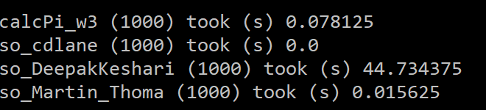
Profiling via Print
Let’s look at opt_timers.py
Verify StackOverflow code works, at least to 100 digits
Note: Prints are outside timed areas!
Notes:
In VS code terminal:
python3
from opt_timers import *
# Test to make sure they work, briefly look at each one
w3_soln.calcPi(100)
so_DeepakKeshari.calcPi(100)
so_Martin_Thoma.calcPi(100)
so_cdlane.calcPi(100)
# Let’s look at how to time it. Note that the print is outside the timer, even the diff time.
timer_test_1(100) # then add a zero for
timer_test_1(1000)
# It is a pain to do a bunch that way to let’s make a function to make it easier but we have to make sure our function is still good
timer_test_2(1000) # run it a few times
# Let’s look at all four algorithms now that we’re pretty sure we are measuring the same thing each time
timer_test_3(1000) # stuck here, ask for questions, tell python joke
# Remember, I got these off the net without looking at them much. They may have been programmed with the intention of showing an algorithm or with no care at all for speed.
# That cdlane one… let’s try that with a higher number of digits of pi to make sure it is working
timer_test_4(10000)
Choosing between algorithms didn’t even have to look at them enough to understand them. All so easy.
Optimization is easy! And in many ways it truly is.
Have to make sure you are measuring the function and not the measuring the measuring function: don’t time the print.
But also, it is an interpreter with other things running on your computer, you may need to run it a few (hundred) times to make sure you get a good, consistent value.
Of course, with this example, we knew where our bottle neck was here, we only had these functions.
But in real life, you often get handed code.

Slide 7
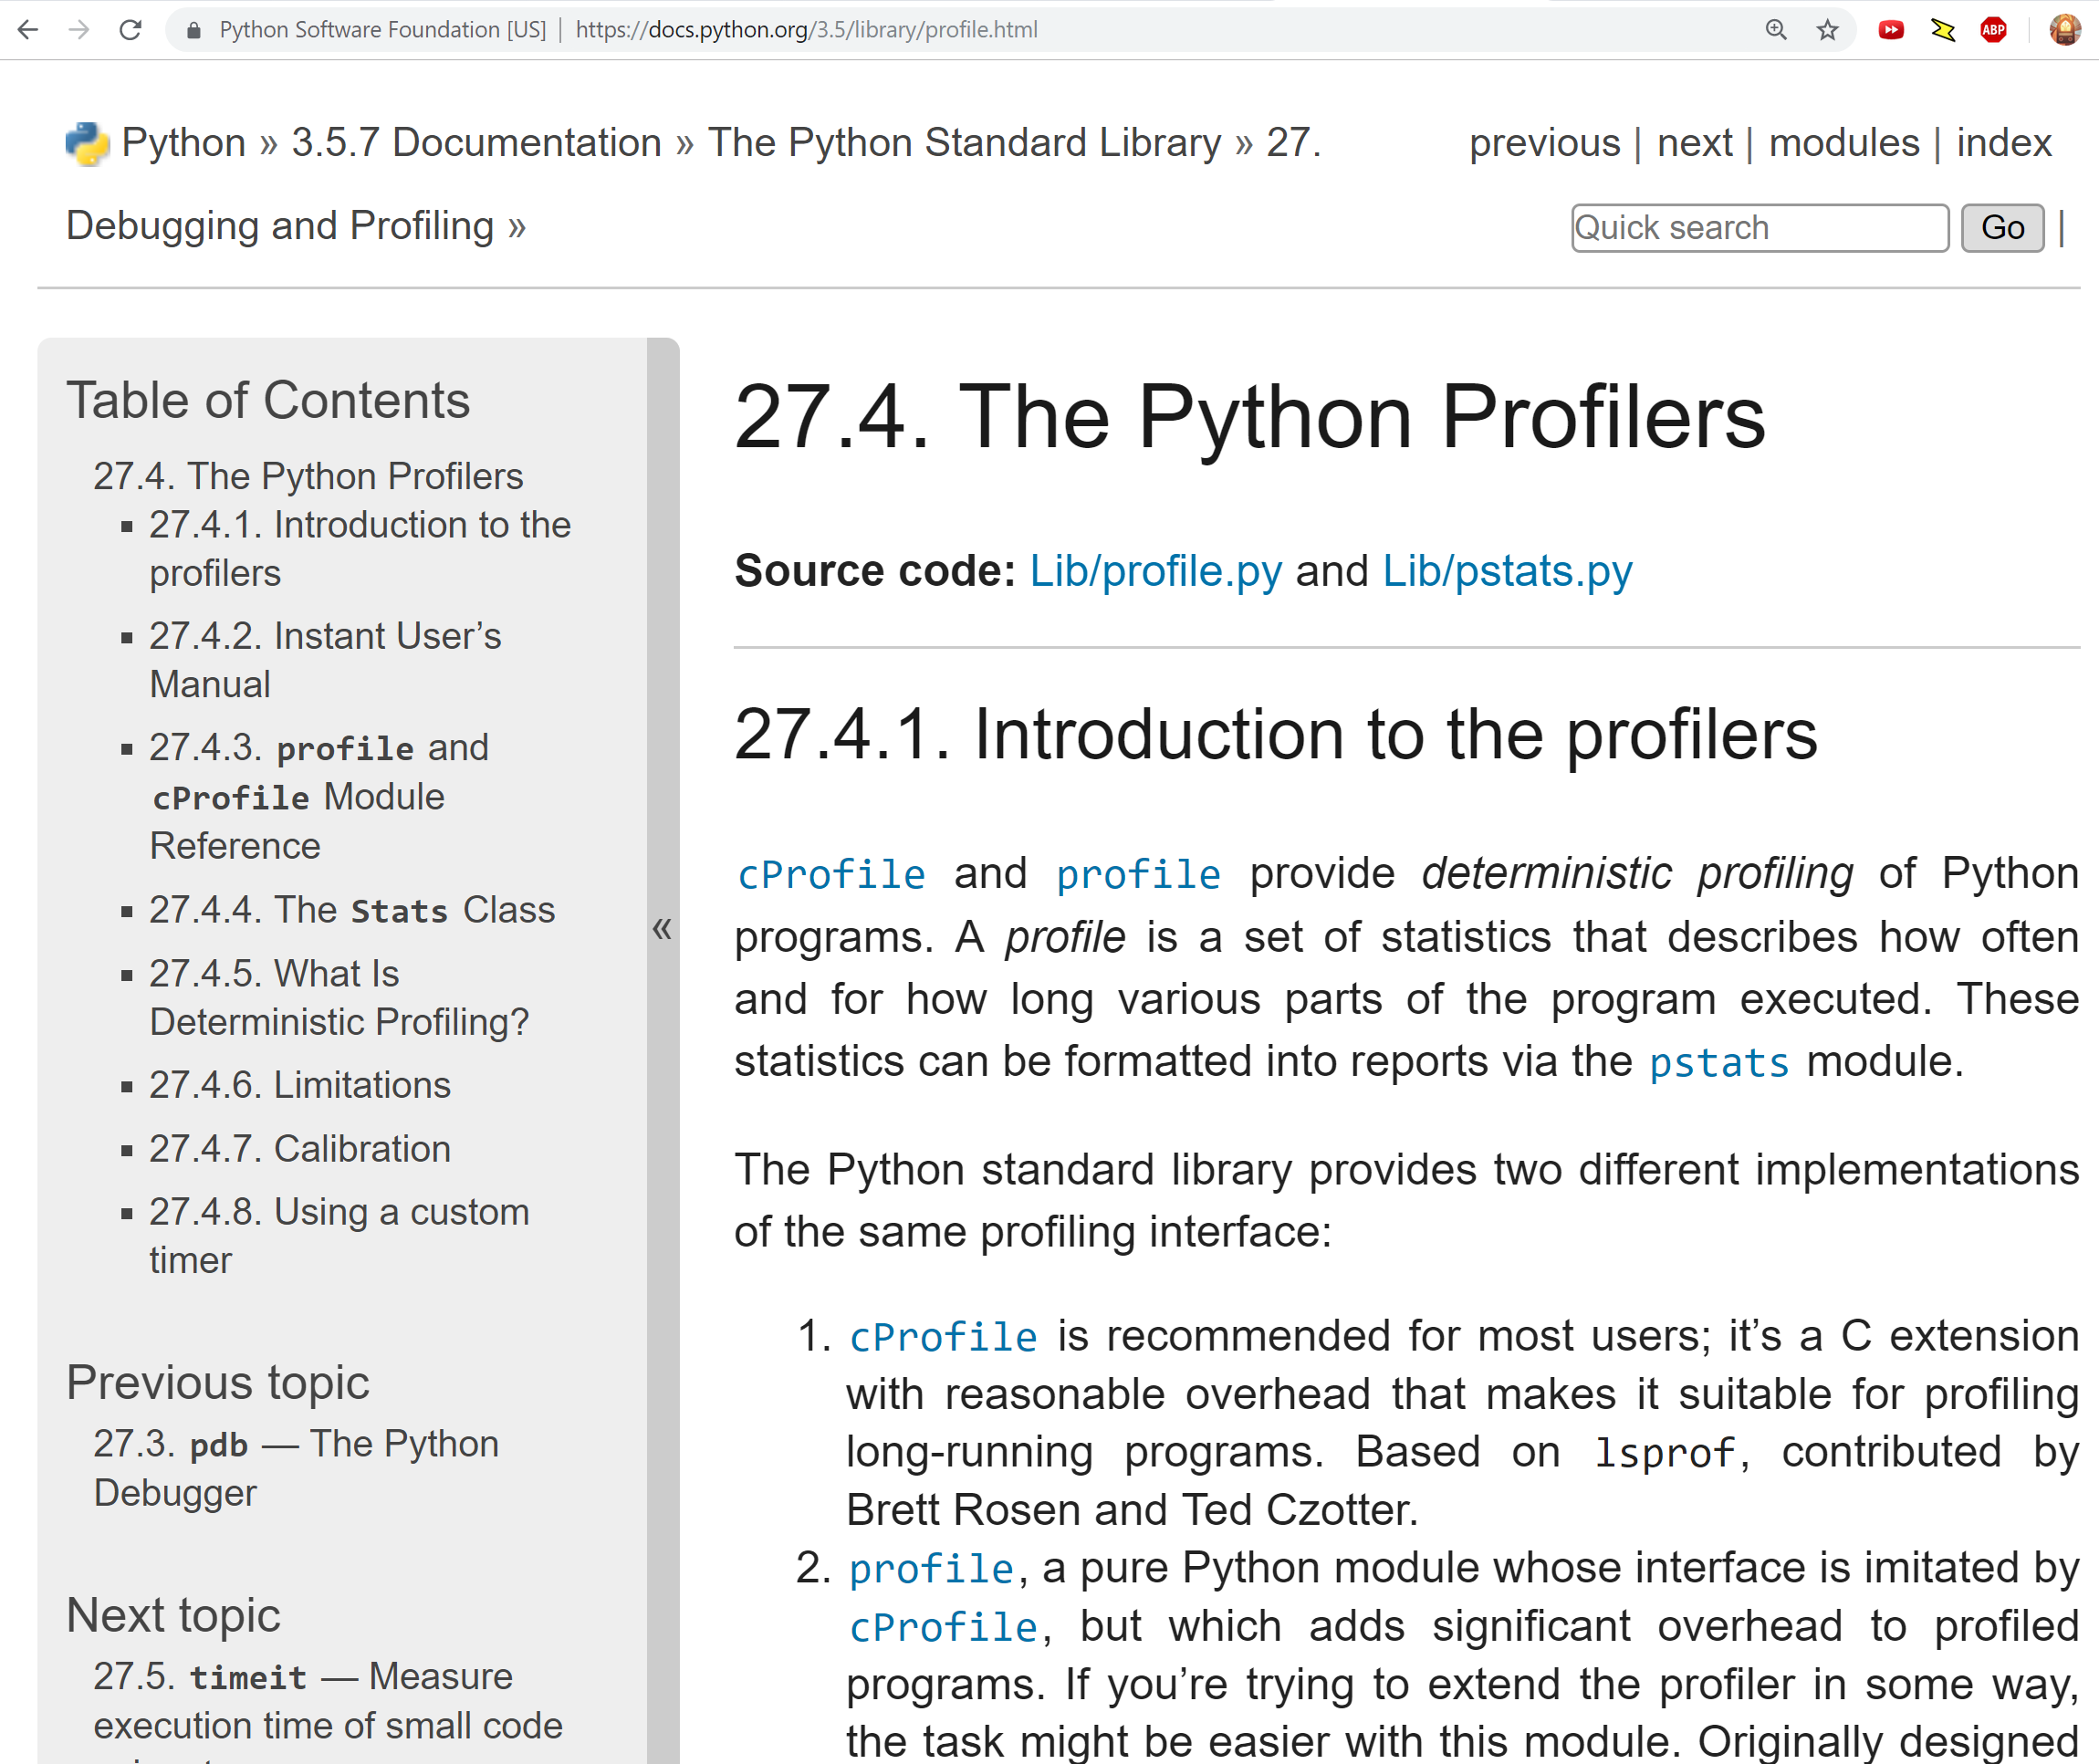
Python’s Built-in Profiler
Command line or in code
Wall of statistics
Mostly look at cumulative
Look at bottlenecks!
Notes:
What if we want to know what was taking so long in a complex system?
Let’s look at python’s built-in profiler, cProfile. Let’s also switch to a slightly different file for this opt_profiler_built_in.py
Got through that file looking at results as we go along
As you may have realized, these numbers are exhausting. Of course, you can do lots of things to make them easier.

Slide 8
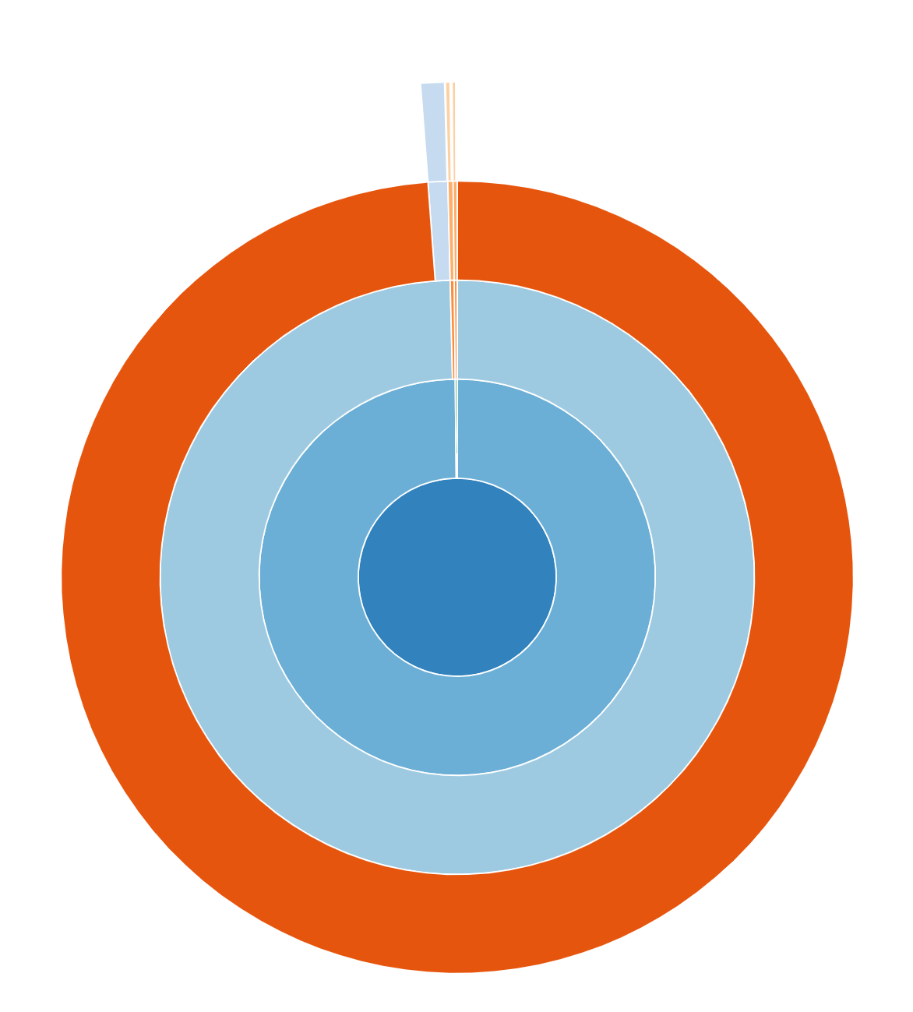
Visualize Whirled Statistics
Notes:
pip3 install snakeviz
snakeviz so_DeepakKeshari.cprof
Browser window: follow paths, different views, look at bottom
snakeviz so_DeepakKeshari_function.cprof
A lot of other cruft, look at just the function
snakeviz so_cdlane_function.cprof
Look at a different function
Builtins are fast, libraries like numpy and tensorflow are fast, you don’t optimize those

Slide 9
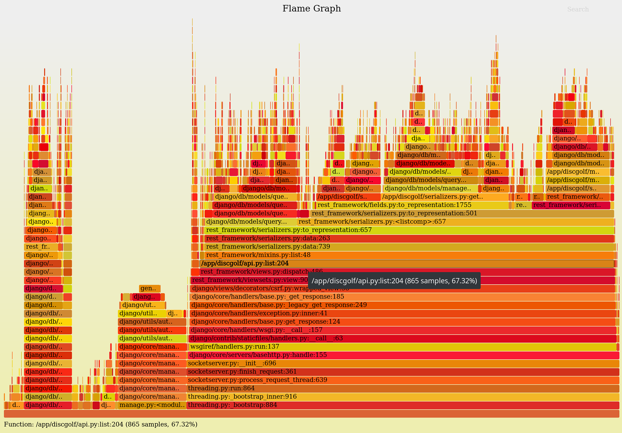
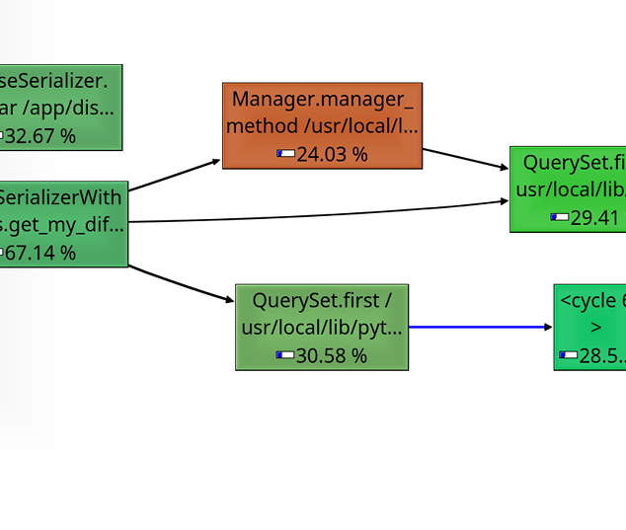
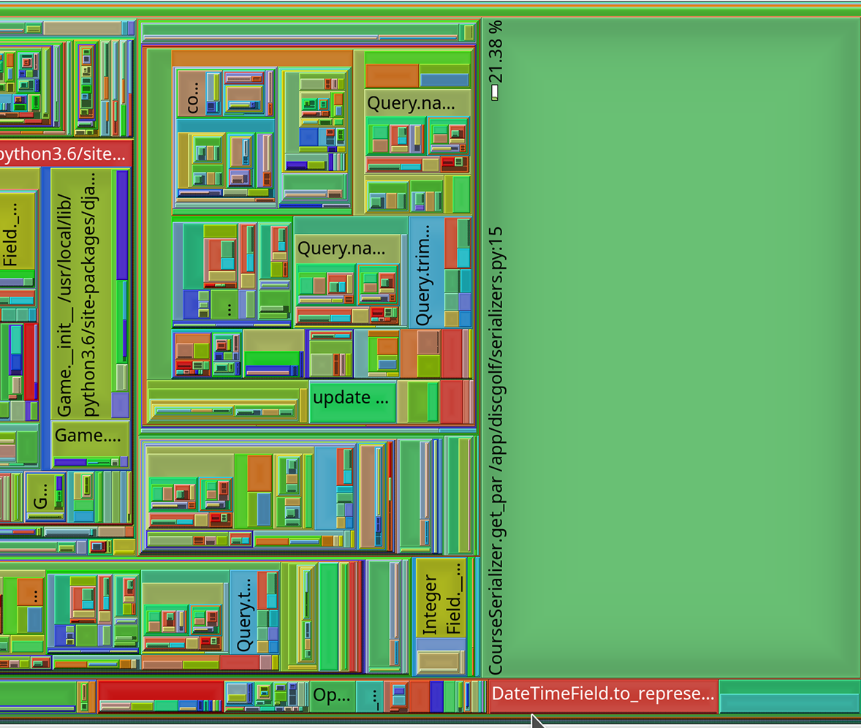
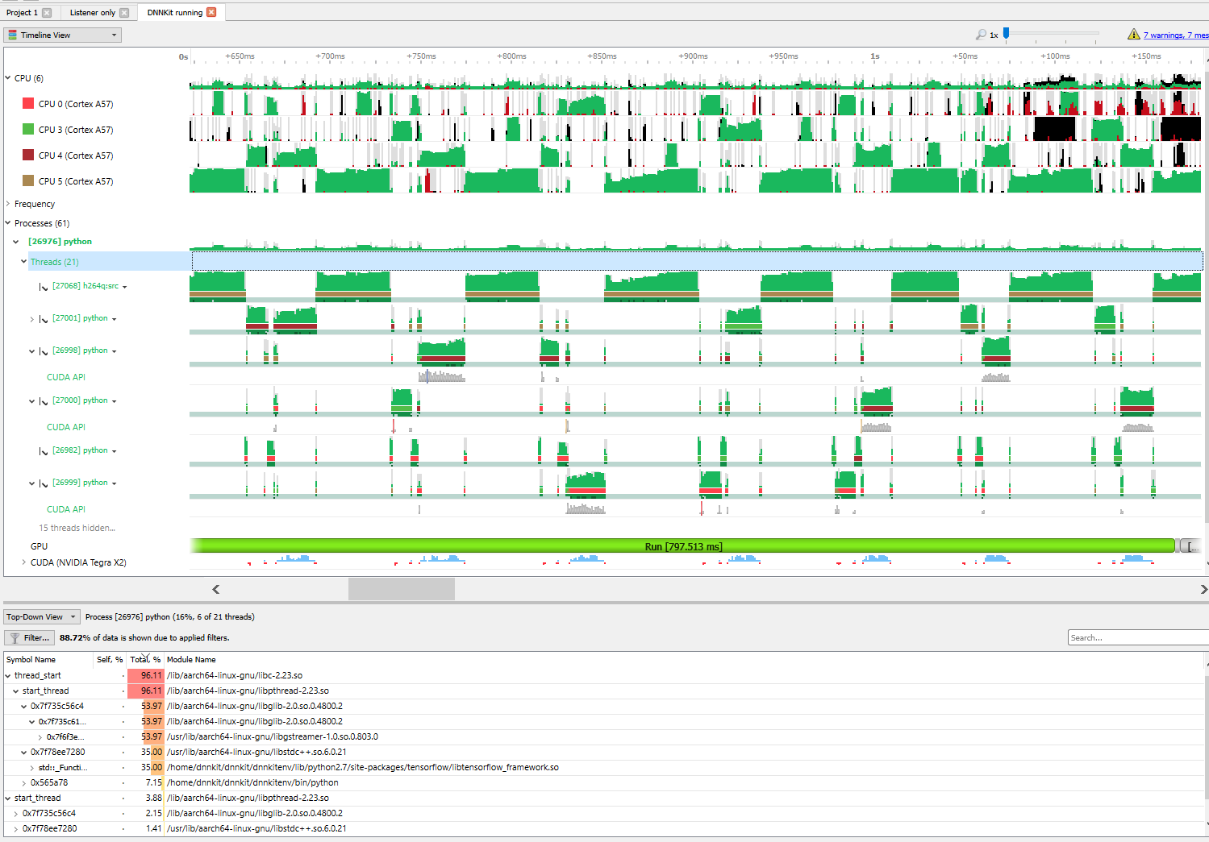
Different Visualizers
Notes:
Snakeviz is the worst of them, really…
I could show you others and tell you about them but other people have done that, you don’t need me for it.
Explore the image here:
https://rivolaks.com/posts/profiling-python/
Search: tooltip for pyflame
Call graphs, useful for more than execution times
Treemaps are very useful for something
Flame charts … like snakeviz’s icicle but upside down
Call graphs, areas, charts
One of them will tell you exactly what you need to know
Oh and Mac and Linux are easier than Windows

Slide 10

Threads, why did it have to be threads?
Notes:
Moving on from profilers and graphs, we need to get start having snake jokes.
Actually, threads…
Why calculate one version of pi at a time, I have four processors?
Why not calculate four?
Python has “threads”
Global interpreter lock: GIL
You can’t use real threads in python…. Memory management is not thread safe
Unless you use a library like Gstreamer or TensorFlow that cheats
When you get there, well, profiling becomes difficult and other tools may be more helpful. Why?

Slide 11

Statistical vs Deterministic
Deterministic:
Follows processor through everything it does.
Logical, orderly, slow
Statistic:
Interrupts CPU: what are you doing now? What about now? Now? Now?
Better for threads, big programs
This Photo by Unknown Author is licensed under CC BY-NC-ND
Notes:
So far we’ve been using deterministic profilers. But when you have multiple threads or a very computationally intensive program, you need to switch to a statistical profiler.
Let me explain the different using butterflies.
Demonstrate a deterministically profiled system of drawing a butterfly. Loosely, each section is timed, like our original timer profilers.
See Butterfly document.
Body
Wing outline
Antenna
Face
Legs
Wing decoration
Other decoration
Background
What if instead of following the processor through what it is doing, we could just ask it every once in awhile? Over enough time, it should work out.
Everyone, please pull out pen and paper or grab a marker and go to the board.
draw a butterfly
Stop a few times, important to not stop every second precisely because computers have clocks

Slide 12
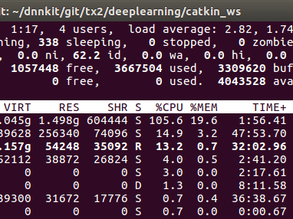
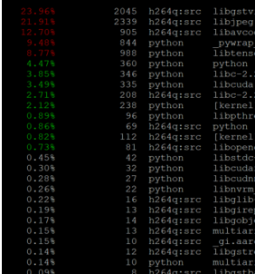
System Tools in Linux top perf: perf top -p <PID> -a -ns comm,dso
Notes:
There are python tools but remember what I said about GIL and python not having real threads? That means your profilers are not as good.
https://jvns.ca/blog/2018/04/16/new-perf-zine/
Sledgehammer tools from Linux
Shows everything, big picture
Easy to see where things go but if you are optimizing one thing, easy to get distracted
Ignore init! Look at runtime.
Remember: only optimize the bottlenecks

Slide 13
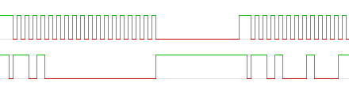
GPIOs, Oscilloscopes, and Logic Analyzers
GPIOs are fast (ok to use in an interrupt)
Compute how much time spent in any area
Show interactions between two threads / interrupts and main code
Use on Circuit Python, Micro Python, Raspberry boards
See signals with a logic analyzer
Saleae $400
Diligent $200
SparkFun $20
Notes:
Whew, multiple processors and Linux tools,
I’m an embedded software engineer, this has all been software so I feel the need to add some hardware here
Hansel and GPIOtel
Set Breadcrumb GPIOs
One reason to optimize is to run on smaller microcontrollers
Circuit Python, Micro Python
** For PyLadies Santa Cruz, I will loan you a tool if you want, I have extras

Slide 14

That’s Rock Not a Dolphin
It was all a lie.
Notes:
My talk was called Optimizing Python but we’ve mostly talked about profiling.
Optimizing is often about finding the right algorithm and using the language efficiently.
It is about using the tools that are there
Python is an expressive language: tell it what you want to do, not how to do it
Idiomatic Python: slices and lambdas (can be harder to read and develop)
Pandas: if you are using a for loop you are doing it wrong; true of a lot of python
Profiling should show you are in NumPy or Pandas or TensorFlow or a builtin function.
This was why I started talking about interpreted languages vs compiled.
You want to use something that is compiled, Ideally compiled and optimized by other people.

Slide 15


What does it all mean?
Python is interpreted, not compiled. It isn’t always slower.
You should only optimize bottlenecks.
Using print to profile your code is easy though slightly fussy.
There is a built-in Python profiler that is pretty good.
Visualization is to profiling as graphs are to data.
Threads make code go faster but profiling harder.
Deterministic and statistical profilers each have their own place.
Linux tools may be more useful that Python profilers.
GPIOs and oscilloscopes are more fun anyway.
Notes:
I hate having slides read aloud to me but it is either that or a quiz, I want to know if these make more sense to you. Which would you prefer?
Python is interpreted, not compiled. It isn’t always slower.
Why is an interpreted language slower than a compiled one?
You should only optimize bottlenecks.
What should you not optimize? (Fast parts, init, things you don’t care about)
Using print to profile your code is easy though slightly fussy.
If you get wildly different results each time your run your program, what are some of the things you can do?
There is a built-in Python profiler that is pretty good.
What is your favorite sort method for looking a profiler results?
Threads make code go faster but profiling harder.
Is the GIL good or bad? Why?s
Deterministic and statistical profilers each have their own place.
Which is the hare and which is the tortoise with respect to different kinds of profilers, why?
Visualization is to profiling as graphs are to data.
What kind of viz is most useful? (Trick question: anything that is useful at the time)
Linux tools may be more useful that Python profilers.
Where do you go to learn more about perf?
GPIOs and oscilloscopes are more fun anyway.
Where can you get a logic analyzer?

Slide 16

Resources
https://godbolt.org/
Profiling
https://docs.python.org/3.5/library/profile.html
https://julien.danjou.info/guide-to-python-profiling-cprofile-concrete-case-carbonara/
Visualization
https://thirld.com/blog/2014/11/30/visualizing-the-results-of-profiling-python-code/
https://rivolaks.com/posts/profiling-python/
Global Interpreter Lock (GIL)
https://realpython.com/python-gil/
https://jvns.ca/perf-zine.pdf
https://circuitpython.org/
https://www.sparkfun.com/products/15033
https://github.com/eleciawhite/pres_optimizingPython

Slide 17

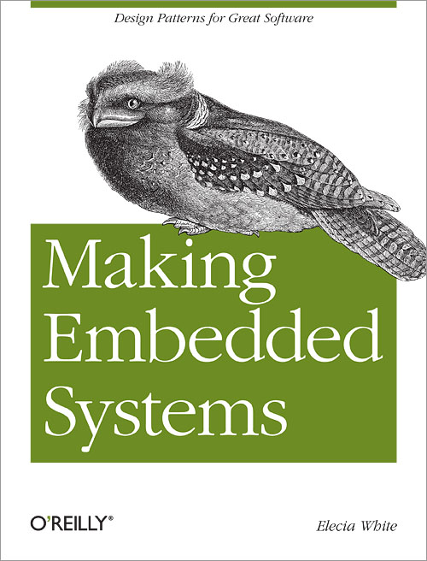
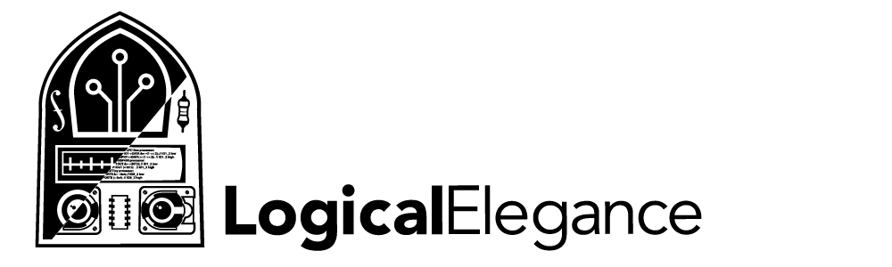
Thank you!
Elecia White
Engineer, Podcast Host, Author
@logicalelegance
Contact link on
embedded.fm or locialelegance.com

